Slide 1
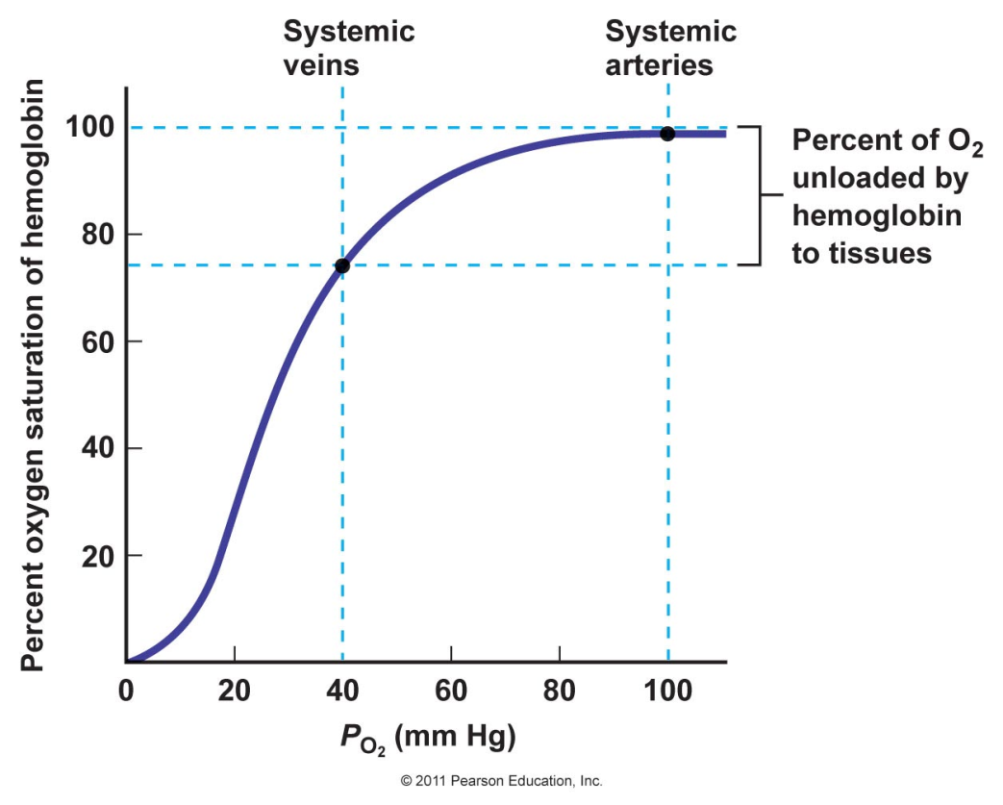
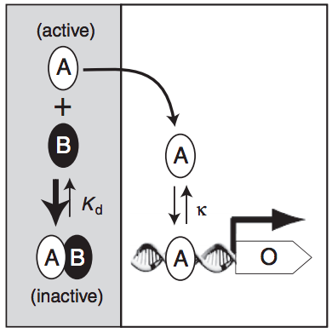
MCB 135 Lecture 7 Inhibition and Cooperativity
Notes:
Walter Pitts, John von Neumann

Slide 2
Today’s Outline
Cooperativity
Review of simple binding
Effect of multiple independent binding sites
Hill curves
Implications for gene regulation
Monod-Wyman-Changeux model
Allosteric regulation
Competitive and non-competitive inhibition
Generation of switch-like behaviors

Slide 3
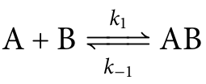
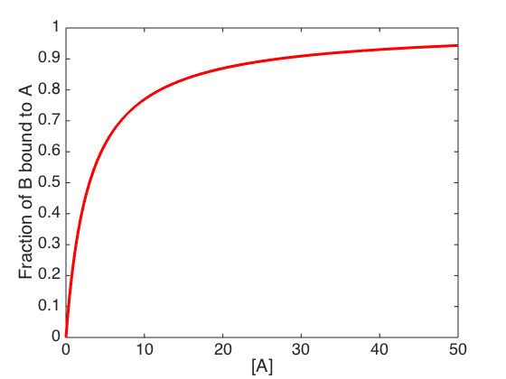
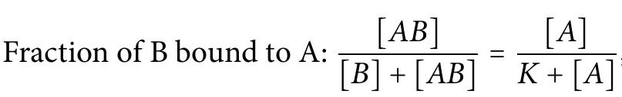
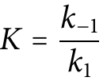
Recap: Simple binding curves are hyperbolic

Slide 4
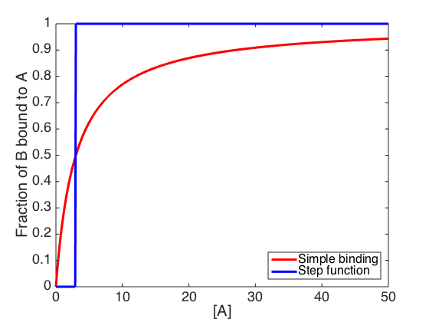
Step functions do not approximate simple binding curves very well

Slide 5
How hard is it to switch from “mostly not bound” to “mostly bound”?

Slide 6
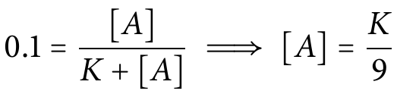
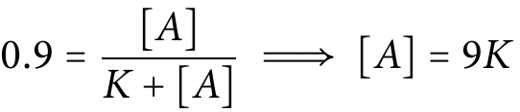
How hard is it to switch from “mostly not bound” to “mostly bound”?
What is [A] when 10% of B is bound to A?
What is [A] when 90% of B is bound to A?
…we must increase [A] by a factor eighty-one!

Slide 7
Hemoglobin, an oxygen-binding protein, has a sigmoidal curve
Switches from 10% to 90% bound over an ≈ four-fold change in oxygen availability

Slide 8
Hemoglobin has four oxygen binding sites: Is this responsible for its sigmoidal curve?

Slide 9
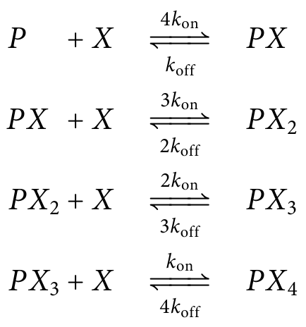
Suppose all four sites are identical and independent (i.e., each site is unaffected by the binding of O₂ elsewhere) with binding reaction rate k_{on} and dissociation reaction rate k_{off}
P: Protein (hemoglobin)
X: Ligand (O₂)
Notes:
P is for protein (hemoglobin) and X represents the ligand – that is, the molecule that the protein is binding – which in the case of hemoglobin is O_2. (Replacing it with X avoids confusion in the subscripts.

Slide 10
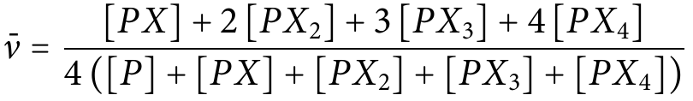
Finding the binding curve when sites are independent
What is the total concentration of binding sites?
What is the total concentration of bound sites?
What is the fraction of sites bound?

Slide 11
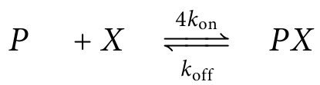
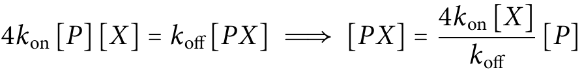
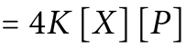
Finding the binding curve when sites are independent
Assume that equilibrium has been reached:

Slide 12
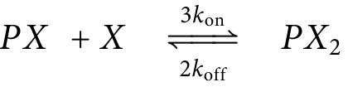
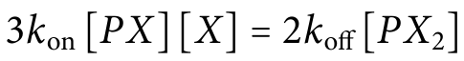
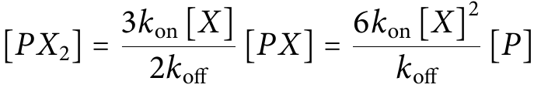
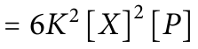
Finding the binding curve when sites are independent
Assume that equilibrium has been reached:

Slide 13
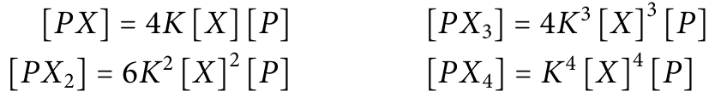
Finding the binding curve when sites are independent
Find expressions for the concentration of each complex by this method:
Then plug them into our expression for the fraction of sites bound:

Slide 14
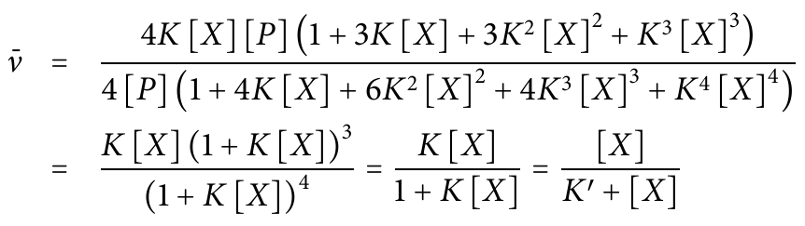
Finding the binding curve when sites are independent
Four independent binding sites cannot explain hemoglobin’s sigmoidal binding curve!

Slide 15
If the sites are not independent, then binding affinity at each site depends on the occupancy of the other sites.
Perhaps the sites are also not identical.
How could this be modeled?

Slide 16
Modeling with non-identical, non-independent binding sites
How many distinct states of oxygen binding are there?
2⁴ = 16
How many transitions are there out of any given state (that involve gaining or losing a single O₂ molecule)?
4
How many “on” and “off” reaction rates are there to fit?
16 x 4 = 64
A
B
C
D

Slide 17

“With four parameters I can make an elephant, and with five I can make him wiggle his trunk.”
-- John von Neumann

Slide 18
Modeling with identical, non-independent binding sites
How many distinct states of oxygen binding are there?
5
How many transitions are there out of a given state (that involve gaining or losing a single O₂ molecule)?
1 (P and PX₄) or 2 (PX, PX₂, and PX₃)
How many “on” and “off” reaction rates are there to fit?
8

Slide 19
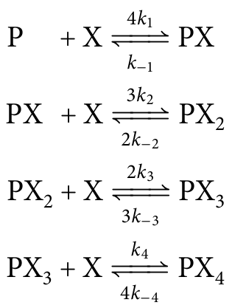
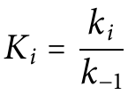
Modeling with identical, non-independent binding sites
Define four association
constants, K_{i}:

Slide 20
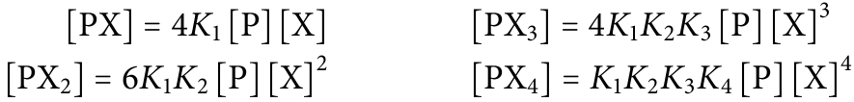
Finding an expression for the fraction of sites bound
Find expressions for the concentration of each complex by this method
Then plug them into our expression for the fraction of sites bound:

Slide 21
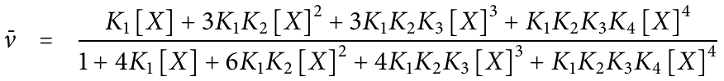
Finding an expression for the fraction of sites bound
This general expression is called the Adair equation.

Slide 22
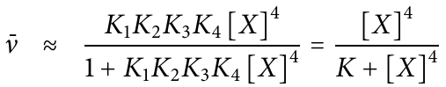
Finding an expression for the fraction of sites bound
A special case: K₄ >> K₁, K₂, K₃
This is an example of cooperativity because the binding of earlier molecules “helps” the last one bind.

Slide 23
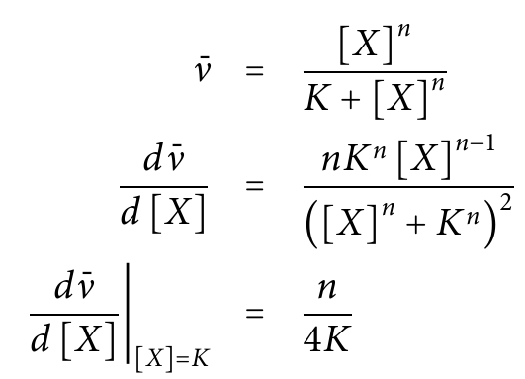
Cooperativity and Hill curves
… is just a specific example of a Hill equation.
Hill coefficient
(always ≤ # of binding sites)
The Hill equation:

Slide 24
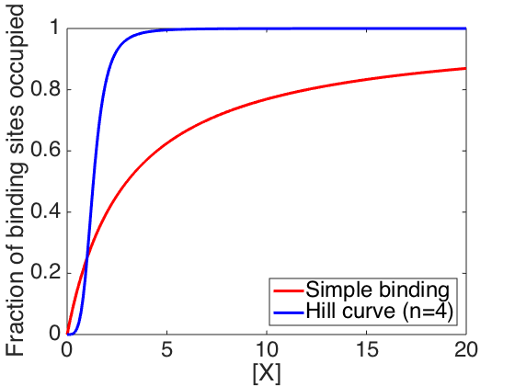
Comparing simple and cooperative binding

Slide 25
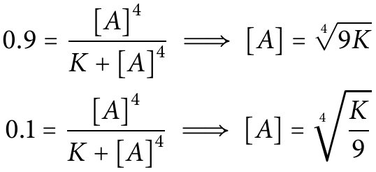
How hard is it to switch from “mostly not bound” to “mostly bound”?
What is [X] when 10% of sites are bound?
What is [X] when 90% of sites are bound?
…we must increase [A] 3-fold (not 81-fold)!

Slide 26
Hey, not bad!
Switches from 10% to 90% bound over an ≈ four-fold change in oxygen availability

Slide 27
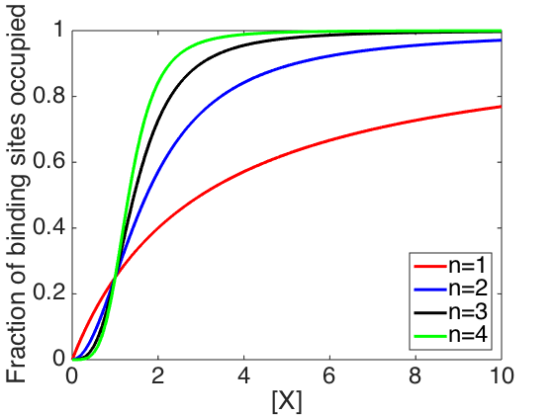
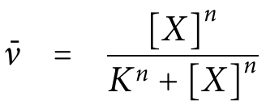
The maximum slope of the Hill curve is proportional to n
Notes:
Applying the quotient rule

Slide 28
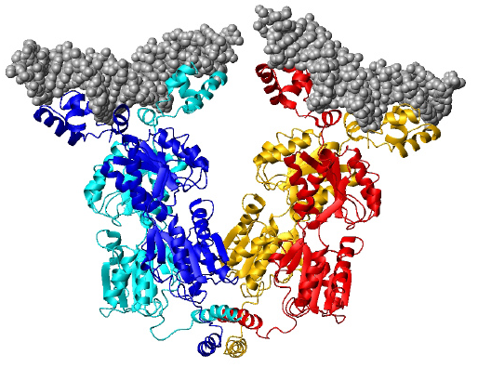
Cooperativity in transcription factor binding
The Lac repressor is a dimer-of-dimers.
Its three binding sites are within 500 bp of each other in a 5 Mbp genome.
Lac repressor binding sites
Notes:
Which site do you think is the “functional” one?

Slide 29
Cooperativity in transcription factor binding
Finding the first site is slow.
Once bound, the other end of the protein more quickly finds a second, nearby, binding site.
Notes:
There has to be a good tethering analogy for this.

Slide 30
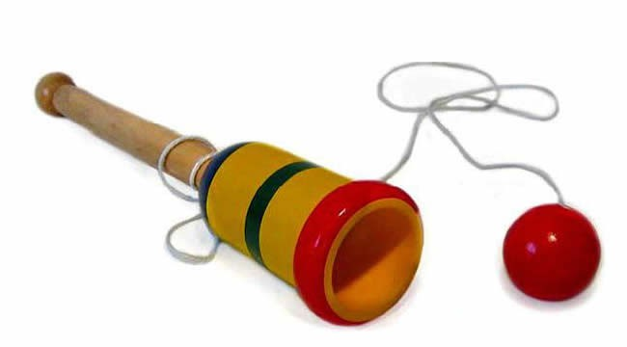
Cooperativity in transcription factor binding
Finding the first site is slow.
Once bound, the other end of the protein more quickly finds a second, nearby, binding site.
If the repressor falls off of one site, it can quickly reattach.
Notes:
Lac repressor (and another favorite example of molecular biology, the lambda phage repressor) both work in this way. Other transcription factors are dimers, but with both sites just a small distance from one another (usually inverted) which accounts for why many DNA-binding proteins have palindromic recognition sequences. Not all transcription factors work this way, however.

Slide 31
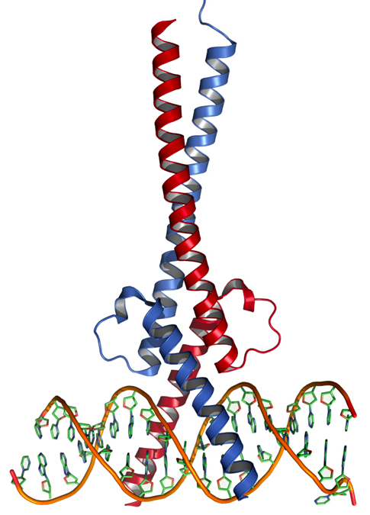
Many transcription factors are dimers that bind palindromic sequences
Example:
Basic helix-loop-helix/leucine zipper transcription factors
5’-TTACGTAA-3’
3’-AATGCATT-5’
Notice that in this case the two binding sites are right next to one another.
Notes:
Similar trick but on a smaller distance scale

Slide 32
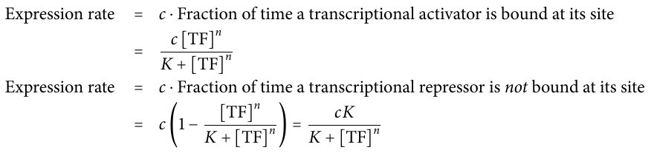
A Hill curve can describe the rate of target gene transcription
For a gene regulated by a transcriptional activator
(with maximum expression rate c):
For a gene regulated by a transcriptional repressor:
(Assumes that the “average fraction of sites occupied” is a good estimate of the “fraction of time a given site is occupied.”)
Notes:
You’ll find this assumption in chapter 2 of Uri Alon’s book (where he describes modeling dynamics of gene expression).
No explanation of why the binding is considered to be cooperative is usually given, but now you know: because transcription factors often bind their sites cooperatively.

Slide 33
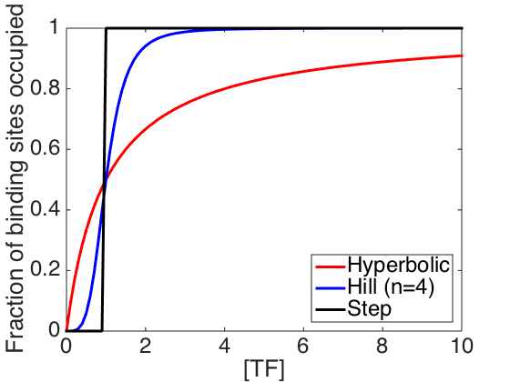
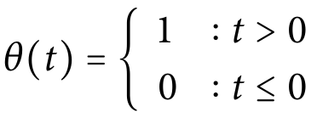
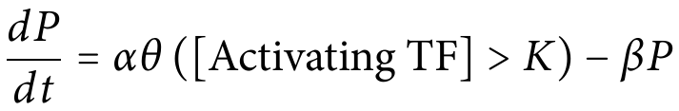
In the Alon textbook, Hill curves are approximated as logic functions
The variable t can be a Boolean:
True: 1
False: 0
Notes:
You’ll find this assumption in chapter 2 of Uri Alon’s book (where he describes modeling dynamics of gene expression).
No explanation of why the binding is considered to be cooperative is usually given, but now you know: because transcription factors often bind their sites cooperatively.

Slide 34
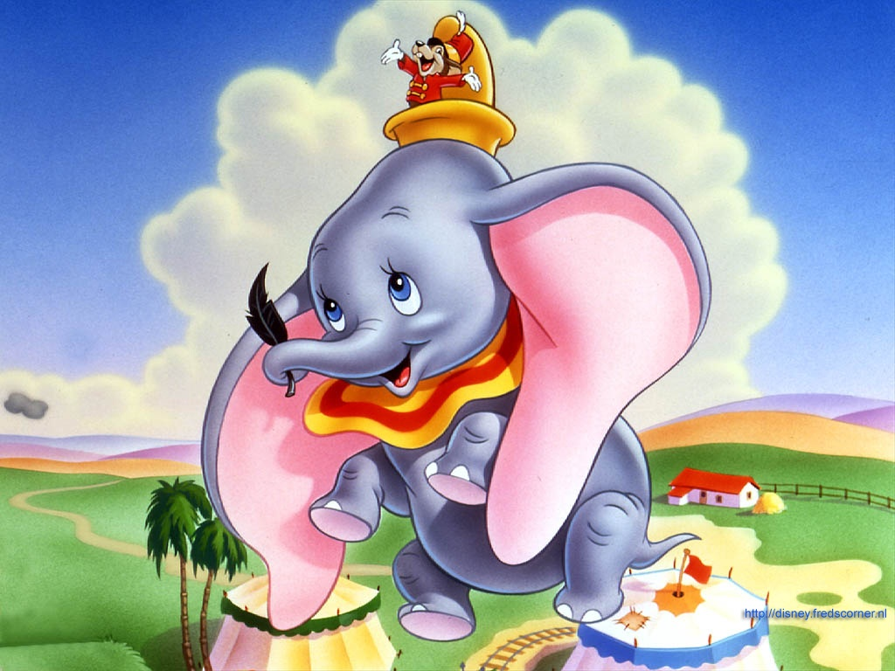
Is there a biological reason to choose this eight-parameter model for hemoglobin?
or is there a simpler, more biologically-grounded explanation for cooperativity?

Slide 35
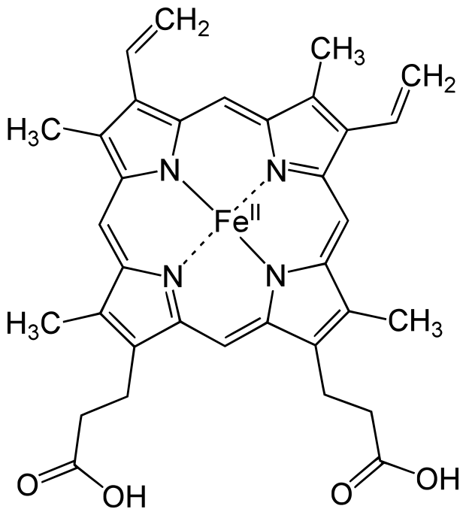
An iron atom in a small molecule called heme binds oxygen
Notes:
Iron sits just a little bit up and out of this plane.

Slide 36
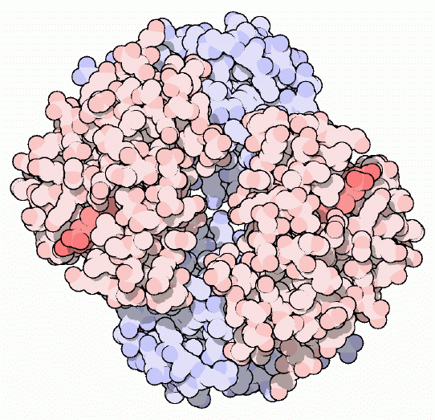
Heme is present at each of hemoglobin’s four O₂ binding sites
Two of four heme groups
Amino acid side chains in hemoglobin interact with each heme molecule to hold it in place
~ 4 nm
PDB May 2003 Molecule of the Month

Slide 37
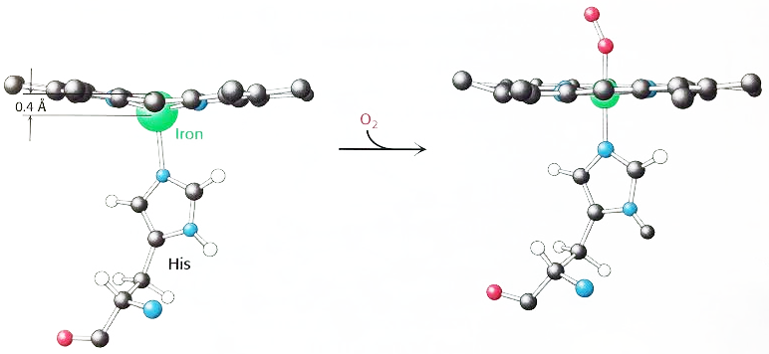
Oxygen binding pulls upward on an amino acid bound to the iron atom
Superoxide (O₂⁻)
Fe²⁺
Fe³⁺
Pulling this amino acid causes others, attached through the protein’s backbone, to move as well

Slide 38
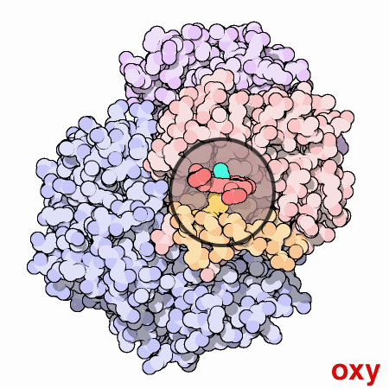
Those local movements have global effects on hemoglobin’s shape
Hemoglobin’s structure has been determined when:
No O₂ is bound (1960)
All sites have O₂ bound (1970)
This animation shows both of those structures and simulates a transition between them.

Slide 39
Monod-Wyman-Changeux (1965)
Hemoglobin exists in two folding states, tensed/taut (T) and relaxed (R)
Essentially the “oxy” and “deoxy” crystal structures just shown, but with variable numbers of O₂ molecules bound
All four binding sites behave identically
Binding sites in R-state hemoglobin have a higher affinity for oxygen

Slide 40
Monod-Wyman-Changeux (1965)
Taut/Tense (T) state
K_{T}
K_{T}
K_{T}
K_{T}
O₂
O₂
O₂
O₂
O₂
O₂
O₂
O₂
O₂
O₂
L
K_{R}
K_{R}
K_{R}
K_{R}
O₂
O₂
O₂
O₂
O₂
O₂
O₂
O₂
O₂
O₂
Relaxed (R) state
…only three parameters! (L, K_{R}, K_{T})
Notes:
This time we’ll treat just the two-state case to keep it simple.

Slide 41
On problem set 2, you’ll find the expression for fraction of sites bound under the MWC model (with just two sites, for simplicity)
Notes:
Two binding

Slide 42
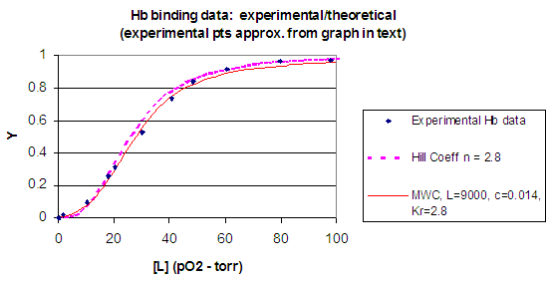
The MWC model fits hemoglobin experimental data well
Fraction of sites bound
Data/plot by Henry Jakubowski

Slide 43
Cooperativity is one way to get switch-like behavior from binding curves. But can we regulate binding without changing ligand concentration?

Slide 44

Carbon monoxide and oxygen compete for the same binding sites on hemoglobin:
Oxygen gas:
O
O
>200x
higher
affinity!
Carbon monoxide:
C
O
Notes:
This is why you don’t leave your car o

Slide 45
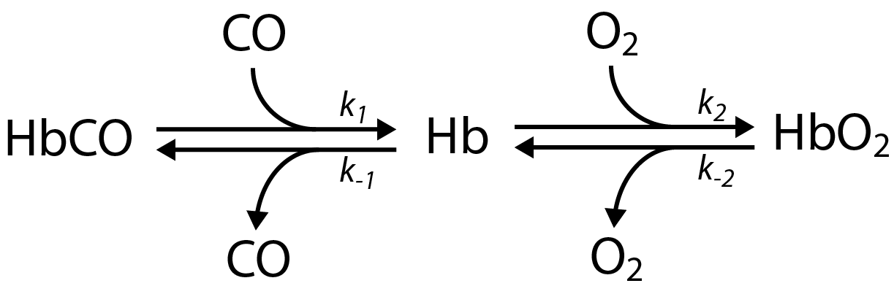
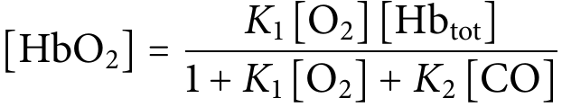
Competitive inhibition of hemoglobin
Suggests a cure: increasing ppO₂!
Notes:
Suggests a cure: add more oxygen! (of course this only works if the timescale for the carbon monoxide binding and unbinding is appropriate.)

Slide 46
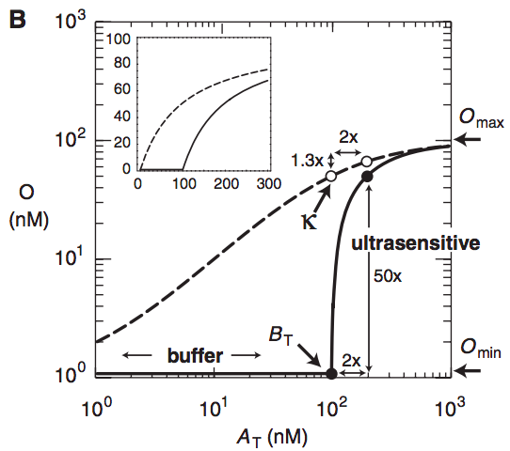
Competitive inhibition can generate switch-like behaviors
Buchler and Cross, 2009

Slide 47
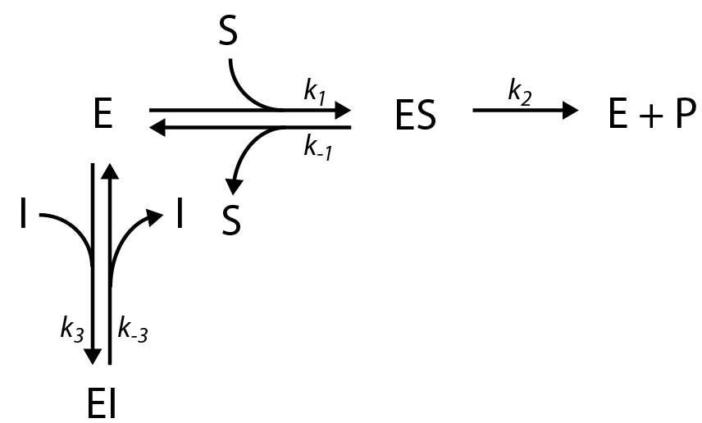
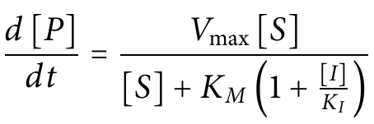
Enzymes also experience competitive inhibition
We can still always reach V_{max} is [S] >>[I]
Notes:
We call the part of the enzyme where the substrates bind the “active site”. If a molecule binds to the active site in such a way that the substrate can’t bind as well, that’s competitive inhibition.

Slide 48
Hemoglobin’s oxygen affinity changes with environmental cues
Cellular respiration uses up O₂ & produces CO₂
Tissues that need O₂ the most tend to have high [CO₂]
Carbon dioxide is carried through blood in several ways:
Bound by hemoglobin (~10%)
Converted to carbonic acid (~80%)
Notes:
Carbonic anhydrase is an extremely efficient enzyme (diffusion-limited)

Slide 49
Hemoglobin’s oxygen affinity changes with environmental cues
Cellular respiration uses up O₂ & produces CO₂
Tissues that need O₂ the most tend to have high [CO₂]
Carbon dioxide is carried through blood in several ways:
Bound by hemoglobin (~10%)
Converted to carbonic acid (~80%)
Both pH sensitivity and CO₂ binding regulate hemoglobin’s affinity for oxygen
Notes:
Carbonic anhydrase

Slide 50
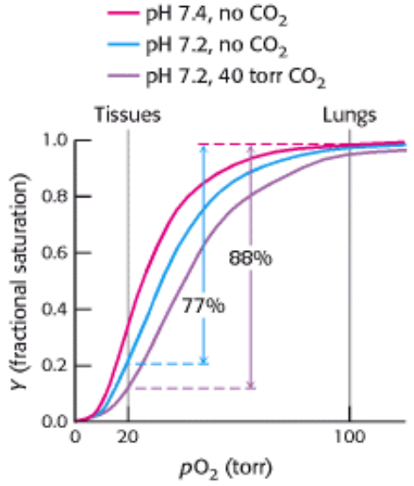
The Bohr Effect
Unlike carbon monoxide, CO₂ and H⁺ don’t get anywhere near the O₂ binding sites.
We say that they influence O₂ affinity allosterically.
Stryer Fig. 7.21
Notes:
Surprisingly, not all inhibitors of oxygen binding are bad.
From Greek for “other” + “shape”
Just as binding of oxygen triggered long-range effects on the shape of hemoglobin, these molecules cause changes in the shape of the oxygen binding sites though they bind elsewhere.

Slide 51
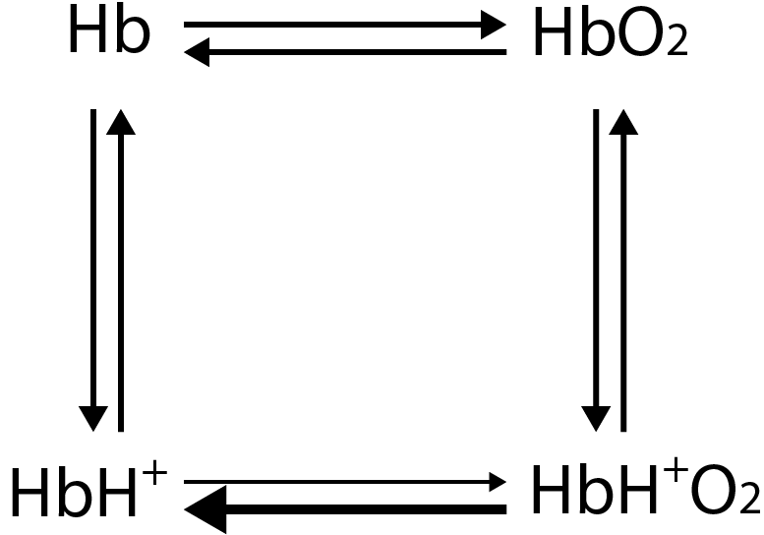
Allosteric inhibition in hemoglobin
Unlike carbon monoxide poisoning, this oxygen release is adaptive
Notes:
Unlike with carbon monoxide, this is a totally adaptive response since it results in oxygen release at the tissues that need it most.

Slide 52


Non-competitive inhibition of enzymes
Can’t reach the original V_{max} just by adding more S

Slide 53

Next time: Zero-order ultrasensitivity

